Slide 1
3D Game Basic
10th class
Lights and Effects
Handityo aulia putra

Slide 2
Lights and Effects

Slide 3
Lights and Effects
In this topic, we will cover:
Using lights and cookie textures to simulate a cloudy day
Adding a custom Reflection map to a scene
Creating a laser aim with Projector and Line Renderer

Slide 4
Lights and Effects - Introduction
Light manipulation and effects are great way to:
Make a better-looking game
Add interesting features
In this topic, we will look at the creative ways of using lights and effects, and also take a look at some of Unity's new features, such as
Procedural Skyboxes,
Reflection Probes,
Light Probes, and
custom Reflection Sources.

Slide 5
Lights and Effects - Introduction
Lighting is an area that has received a lot of attention from Unity.
Lightning now features real-time Global Illumination technology provided by Enlighten.
This new technology provides better and more realistic results for both real-time and baked lighting.
For more information on Unity's Global Illumination system, check out its documentation at http://docs.unity3d.com/Manual/GIIntro.html

Slide 6
Lights and Effects - Introduction
There are many ways of creating light sources in Unity.
Lights
Environment Lighting
Emission materials
Projector
Lightmaps and Light Probes
The Lighting window

Slide 7
Lights and Effects - Lights
Lights are placed into the scene as game objects, featuring a Light component.
They can function in
Realtime,
Baked, or
Mixed modes.
Among the other properties, they can have their Range, Color, Intensity, and Shadow Type set by the user.
For an overview of the light types, check Unity's documentation at http://docs.unity3d.com/Manual/Lighting.html

Slide 8
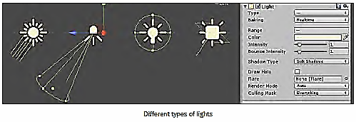
Lights and Effects - Lights
There are four types of lights:
Directional Light: This is normally used to simulate the sunlight
Spot Light: This works like a cone-shaped spot light
Point Light: This is a bulb lamp-like, omnidirectional light
Area Light: This baked-only light type is emitted in all directions from a rectangle-shaped entity, allowing for a smooth, realistic shading

Slide 9
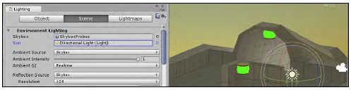
Lights and Effects - Environment Lighting
Unity's Environment Lighting is often achieved through the combination of
a Skybox material and
sunlight defined by the scene's Directional Light.
Such combination creates an ambient light that is integrated into the scene's environment, and which can be set as Realtime or Baked into Lightmaps.

Slide 10
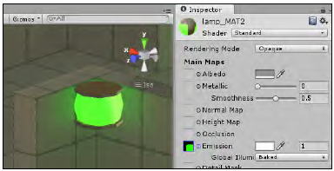
Lights and Effects – Emissive materials
When applied to static objects, materials featuring the Emission colors or maps will cast light over surfaces nearby,
in both real-time and baked modes, as shown in the following screenshot:

Slide 11
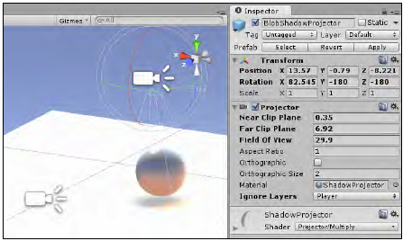
Lights and Effects – Projector
As its name suggests, a Projector can be used to simulate projected lights and shadows, basically by projecting a material and its texture map onto the other objects.

Slide 12
Lights and Effects – Lightmaps and Light Probes
Lightmaps
texture maps generated from the scene's lighting information and applied to the scene's static objects in order to avoid the use of processing-intensive real-time lighting.
Light Probes
a way of sampling the scene's illumination at specific points in order to have it applied onto dynamic objects without the use of real-time lighting.

Slide 13
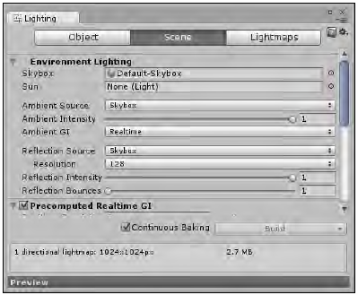
Lights and Effects – The Lighting window
The Lighting window, which can be found through navigating to the Window | Lighting menu.
The Lighting window is the hub for setting and adjusting the scene's illumination features, such as
Lightmaps,
Global Illumination,
Fog,
and much more.

Slide 14
Mini-project 10-1: Using lights and cookie textures to simulate a cloudy day

Slide 15
Using lights and cookie textures to simulate a cloudy day
In many first-person shooters and survival horror games, lights and shadows can add a great deal of realism to a scene, helping immensely to create the right atmosphere for the game.

Slide 16
Using lights and cookie textures to simulate a cloudy day
In this project, we will create a cloudy outdoor environment using cookie textures.
Cookie textures work as masks for lights.
It functions by adjusting the intensity of the light projection to the cookie texture's alpha channel.
This allows for a silhouette effect (just think of the bat-signal) or, as in this particular case, subtle variations that give a filtered quality to the lighting.

Slide 17
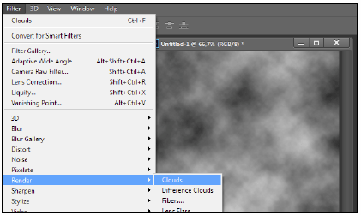
Using lights and cookie textures to simulate a cloudy day
If you don't have access to an image editor, or prefer to skip the texture map elaboration in order to focus on the implementation, please use the image file called cloudCookie.tga.
1. In your image editor,
create a new 512 x 512 pixel image.
2. Using black as the foreground color and white as the background color,
apply the Clouds filter
(in Photoshop, this is done by navigating to the Filter | Render | Clouds menu).
3. Save your image file as cloudCookie.PSD or TGA.

Slide 18

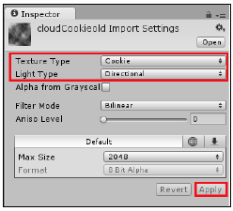
Using lights and cookie textures to simulate a cloudy day
4. Import your image file to Unity and select it in the Project view.
5. From the Inspector view,
change its Texture Type to Cookie and its Light Type to Directional. Then, click on Apply:

Slide 19
Unity : Cookies
Unity lights allow you to add cookies in the form of textures;
these provide an efficient way to add atmosphere to a scene.
Cookies are often used to change the shape of a light so it matches a detail “painted” in the scene.
For example, a dark tunnel may have striplights along the ceiling.
If you use standard spot lights for illumination
the beams will have an unexpected round shape
but you could use cookies to restrict the lights to a thin rectangle.
A monitor screen may cast a green glow onto the face of the character using it but the glow should be restricted to a small box shape.

Slide 20
Unity : Cookies
Note that a cookie need not be completely black and white but can also incorporate any grayscale level.
This can be useful for simulating dust or dirt in the path of the light.
For example,
if a game scene takes place in a long abandoned house,
you could add atmosphere by using “dirty” cookies with noise on the windows and other light sources.
Similarly, car headlight glass usually contains ridges that create “caustic” patterns of slightly lighter and darker areas in the beam; another good use for a cookie.

Slide 21
Using lights and cookie textures to simulate a cloudy day
6. We will need a surface to actually see the lighting effect.
We can either (choose one)
add a plane to the scene (via navigating to the GameObject | 3D Object | Plane menu), or
create a Terrain (menu option GameObject | 3D Object | Terrain) and edit it.

Slide 22
Using lights and cookie textures to simulate a cloudy day
7. Let's add a light to the scene.
Since we want to simulate sunlight, the best option is to create a Directional Light.
We can do this through the drop-down menu named Create | Light | Directional Light in the Hierarchy view.
8. Using the Transform component of the Inspector view, reset the light's
Position to X: 0, Y: 0, Z: 0
Rotation to X: 90; Y: 0; Z: 0.

Slide 23
Using lights and cookie textures to simulate a cloudy day
9. In the Cookie field,
select the cloudCookie texture that you imported earlier.
Change the Cookie Size field to 80, or a value that you feel is more appropriate for the scene's dimension.
Leave Shadow Type as No Shadows

Slide 24
Using lights and cookie textures to simulate a cloudy day
10. Now, we need a script to translate our light and, consequently, the Cookie projection.
Using the Create drop-down menu in the Project view,
create a new C# Script named MovingShadows.cs.
11. Save your script and apply it to the Directional Light.
using UnityEngine;
using System.Collections;
public class MovingShadows : MonoBehaviour{
public float windSpeedX;
public float windSpeedZ;
private float lightCookieSize;
private Vector3 initPos;
void Start(){
initPos = transform.position;
lightCookieSize = GetComponent<Light>().cookieSize;
}
void Update(){
Vector3 pos = transform.position;
float xPos= Mathf.Abs (pos.x);
float zPos= Mathf.Abs (pos.z);
float xLimit = Mathf.Abs(initPos.x) + lightCookieSize;
float zLimit = Mathf.Abs(initPos.z) + lightCookieSize;
if (xPos >= xLimit)
pos.x = initPos.x;
if (zPos >= zLimit)
pos.z = initPos.z;
transform.position = pos;
float windX = Time.deltaTime * windSpeedX;
float windZ = Time.deltaTime * windSpeedZ;
transform.Translate(windX, 0, windZ, Space.World);
}
}

Slide 25
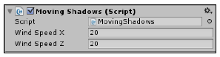
Using lights and cookie textures to simulate a cloudy day
17. Select the Directional Light.
In the Inspector view,
change the parameters
Wind Speed X and
Wind Speed Z to 20.
Play the scene

Slide 26
Using lights and cookie textures to simulate a cloudy day

Slide 27
Using lights and cookie textures to simulate a cloudy day
With the script,
we are telling the Directional Light to move across the X and Z axis,
causing the Light Cookie texture to be displaced as well.
Also, we reset the light object to its original position
whenever it traveled a distance that was either equal to or greater than the Light Cookie Size.
The light position must be reset to prevent it from traveling too far, causing problems in real-time render and lighting.
The Light Cookie Size parameter is used to ensure a smooth transition.

Slide 28
Using lights and cookie textures to simulate a cloudy day
The reason we are not enabling shadows is because
the light angle for the X axis must be 90 degrees
(or there will be a noticeable gap when the light resets to the original position).
If you want dynamic shadows in your scene,
need to add a second Directional Light.

Slide 29
Mini-project 10-2: Adding a custom Reflection map to a scene

Slide 30
Adding a custom Reflection map to a scene
Whereas Unity Legacy Shaders use individual Reflection Cubemaps per material,
the new Standard Shader gets its reflection from the scene's Reflection Source, as configured in the Scene section of the Lighting window.
The level of reflectiveness for each material is now given by its Metallic value or Specular value (for materials using Specular setup).
This new method can be a real time saver,
allowing you to quickly assign the same reflection map to every object in the scene

Slide 31
Adding a custom Reflection map to a scene
For this project,
we will prepare a Reflection Cubemap,
which is basically the environment to be projected as a reflection onto the material.
To help us with this recipe,
it's been provided a Unity package,
containing a prefab made of a 3D object and a basic Material (using a TIFF as Diffuse map), and also
a JPG file to be used as the reflection map.

Slide 32
Adding a custom Reflection map to a scene
1. Import batteryPrefab.unitypackage to a new project.
Then, select battery_prefab object from the Assets folder, in the Project view.
2. From the Inspector view,
expand the Material component and
observe the asset preview window.

Slide 33
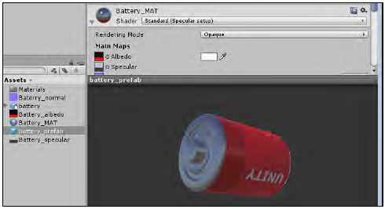

Slide 34
Adding a custom Reflection map to a scene (ver 1)
3. Import the CustomReflection.jpg image file.
From the Inspector view (for unity 5),
change its
Texture Type to Cubemap,
Mapping to Latitude - Longitude Layout (Cylindrical)
check the boxes for Glossy Reflection and Fixup Edge Seams.
Finally,
change its Filter Mode to Trilinear and click on the Apply button.

Slide 35
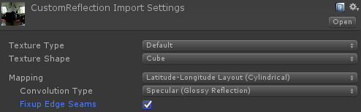
Adding a custom Reflection map to a scene (ver 2)
3. Import the CustomReflection.jpg image file.
From the Inspector view (for unity 2017 and up),
change its
Texture Type to Default,
Texture Shape to Cube,
Mapping to Latitude - Longitude Layout (Cylindrical)
Convolution Type to Specular (Glossy Reflection)
check the boxes for Glossy Reflection and Fixup Edge Seams.
Finally,
change its Filter Mode to Trilinear and click on the Apply button.

Slide 36
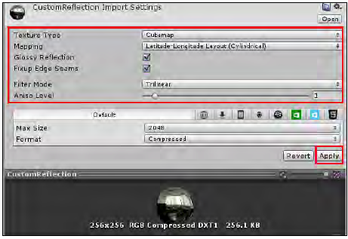
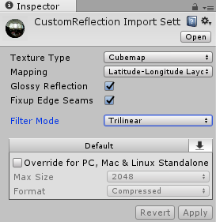

Slide 37
Adding a custom Reflection map to a scene
4. Let's replace the Scene's Skybox with our newly created Cubemap, as the Reflection map for our scene.
In order to do this,
open the Lighting window by navigating to the Window | Lighting menu.
Select the Scene section and use the drop-down menu to change the Reflection Source to Custom.
Finally, assign the newly created CustomReflection texture as the Cubemap,

Slide 38
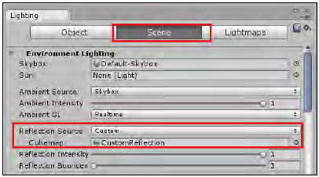

Slide 39
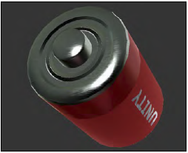
Adding a custom Reflection map to a scene
5. Check out for the new reflections on the battery_prefab object by putting it in the scene

Slide 40
Mini-project 10-3: Creating a laser aim with Projector and Line Renderer

Slide 41
Creating a laser aim with Projector and Line Renderer
In this project we will use:
- BasicScene package
- A texture map named LineTexture
- Assets package: Effects

Slide 42
Creating a laser aim with Projector and Line Renderer
1. Import BasicScene.unitypackage to a new project.
Then, open the scene named BasicScene.
2. Import the Effects package by navigating to the Assets | Import Package | Effects menu (this is part of Standard Asset).
If you want to import only the necessary files within the package, deselect everything in the Importing package window by clicking on the None button, and then check the Projectors folder only.
Then, click on Import

Slide 43
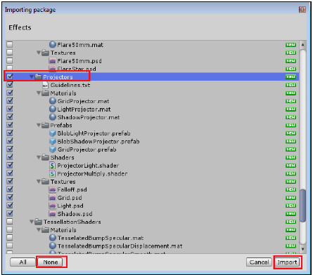

Slide 44
Creating a laser aim with Projector and Line Renderer
3. From the Inspector view,
locate the ProjectorLight shader
(inside the Assets | Standard Assets | Effects | Projectors | Shaders folder).
Duplicate the file and name the new copy as ProjectorLaser.

Slide 45
Creating a laser aim with Projector and Line Renderer
4. Open ProjectorLaser.
From the first line of the code,
change Shader "Projector/Light" to Shader "Projector/Laser".
Then,
locate the line of code – Blend DstColor One and
change it to Blend One One.
Save and close the file.

Slide 46
Unity Shader
The reason for editing the shader for the laser was to make it stronger by changing its blend type to Additive.
Shader programming is a complex subject, if you want to learn more about it, check out Unity's documentation on the subject, which is available at
http://docs.unity3d.com/Manual/SL-Reference.html,
and also the book called Unity Shaders and Effects
Cookbook, published by Packt.

Slide 47
Creating a laser aim with Projector and Line Renderer
5. Now that we have fixed the shader, we need a material.
From the Project view,
use the Create drop-down menu to create a new Material.
Name it LaserMaterial.
Then, select it from the Project view and, from the Inspector view,
change its Shader to Projector/Laser.

Slide 48
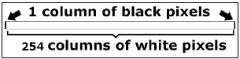
Creating a laser aim with Projector and Line Renderer
6. From the Project view,
locate the Falloff texture.
Open it in your image editor and, except for the first and last columns column of pixels that should be black, paint everything white.
Save the file and go back to Unity.

Slide 49
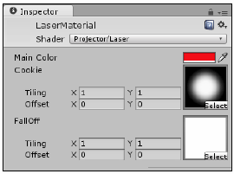
Creating a laser aim with Projector and Line Renderer
7. Change the LaserMaterial's Main Color to red (RGB: 255, 0, 0).
Then, from the texture slots,
select the Light texture as Cookie and the Falloff texture as Falloff.

Slide 50
Creating a laser aim with Projector and Line Renderer
8. From the Hierarchy view,
find and select the pointerPrefab object (MsLaser |mixamorig:Hips | mixamorig:Spine | mixamorig:Spine1 | mixamorig:Spine2 | mixamorig:RightShoulder | mixamorig:RightArm | mixamorig:RightForeArm | mixamorig:RightHand | pointerPrefab).
Then, from the Create drop-down menu, select Create Empty Child.
Rename the new child of pointerPrefab as LaserProjector.

Slide 51
Creating a laser aim with Projector and Line Renderer
9. Select the LaserProjector object. Then, from the Inspector view,
click the Add Component button and
navigate to Effects | Projector.
Then, from the Projector component,
set the Orthographic option as true
set Orthographic Size as 0.1.
Finally, select LaserMaterial from the Material slot.

Slide 52
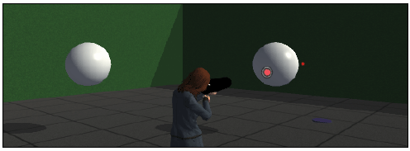
Creating a laser aim with Projector and Line Renderer
10. Test the scene.
You will be able to see the laser aim dot, as shown:

Slide 53
Creating a laser aim with Projector and Line Renderer
11. Now, let's create a material for the Line Renderer component that we are about to add.
From the Project view,
use the Create drop-down menu to
add a new Material.
Name it as Line_Mat.

Slide 54
Creating a laser aim with Projector and Line Renderer
12. From the Inspector view,
change the shader of the Line_Mat to Particles/Additive.
set its Tint Color to red (RGB: 255;0;0).

Slide 55
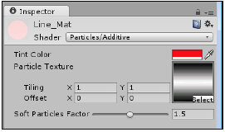
Creating a laser aim with Projector and Line Renderer
13. Import the LineTexture image file.
Then, set it as the Particle Texture for the Line_Mat, as shown:

Slide 56
Creating a laser aim with Projector and Line Renderer
14. Use the Create drop-down menu from Project view to add a C# script named LaserAim.
16. Save your script and attach it to the LaserProjector game object
using UnityEngine;
using System.Collections;
public class LaserAim : MonoBehaviour {
public float lineWidth = 0.2f;
public Color regularColor = new Color (0.15f, 0, 0, 1);
public Color firingColor = new Color (0.31f, 0, 0, 1);
public Material lineMat;
private Vector3 lineEnd;
private Projector proj;
private LineRenderer line;
void Start () {
line = gameObject.AddComponent<LineRenderer>();
line.material = lineMat;
line.material.SetColor("_TintColor", regularColor);
line.SetVertexCount(2);
line.SetWidth(lineWidth, lineWidth);
proj = GetComponent<Projector> ();
}
void Update () {
RaycastHit hit;
Vector3 fwd = transform.TransformDirection(Vector3.forward);
if (Physics.Raycast (transform.position, fwd, out hit))
{
lineEnd = hit.point;
float margin = 0.5f;
proj.farClipPlane = hit.distance + margin;
} else {
lineEnd = transform.position + fwd * 10f;
}
line.SetPosition(0, transform.position);
line.SetPosition(1, lineEnd);
if(Input.GetButton("Fire1")){
float lerpSpeed = Mathf.Sin (Time.time * 10f);
lerpSpeed = Mathf.Abs(lerpSpeed);
Color lerpColor = Color.Lerp(regularColor,
firingColor, lerpSpeed);
line.material.SetColor("_TintColor", lerpColor);
}
if(Input.GetButtonUp("Fire1")){
line.material.SetColor("_TintColor", regularColor);
}
}
}

Slide 57
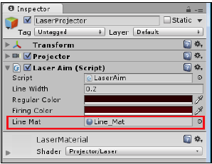
Creating a laser aim with Projector and Line Renderer
17. Select the LaserProjector GameObject.
From the Inspector view,
find the Laser Aim component and
fill the Line Material slot with the Line_Mat material, as shown:

Slide 58
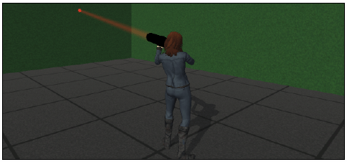
Creating a laser aim with Projector and Line Renderer
18. Play the scene. The laser aim is ready, and looks as shown:

Slide 59
Creating a laser aim with Projector and Line Renderer
In this project,
the width of the laser beam and its aim dot have been exaggerated.
Should you need a more realistic thickness for your beam,
change the Line Width field of the Laser Aim component to 0.05, and
the Orthographic Size of the Projector component to 0.025.
Also, make the beam more opaque by setting the Regular Color of the Laser Aim component brighter.

Slide 60
Creating a laser aim with Projector and Line Renderer
The laser aim effect was achieved by combining two different effects:
A Projector and
A Line Renderer.

Slide 61
Creating a laser aim with Projector and Line Renderer
A Projector can be used to simulate light, shadows, and more.
A component that projects a material (and its texture) onto other game objects.
By attaching a projector to the Laser Pointer object,
we have ensured that it will face the right direction at all times.
To get the right, vibrant look,
we have edited the projector material's Shader, making it brighter.
Also, we have scripted a way to prevent projections from going through objects, by setting its Far Clip Plane on approximately the same level of the first object that is receiving the projection.
The line of code that is responsible for this action is—
proj.farClipPlane = hit.distance + margin;.

Slide 62
Creating a laser aim with Projector and Line Renderer
Regarding the Line Renderer,
we have opted to create it dynamically, via code, instead of manually adding the component to the game object.
The code is also responsible for
setting up its appearance,
updating the line vertices position, and
changing its color whenever the fire button is pressed,
giving it a glowing/pulsing look.

Slide 63
Information

Slide 64
Mid-term Project
Work in a group of 3 people
Topic: a 2D Game
Deadline: November 7th - 8th
You should prepare the finished game and a presentation, which includes
Demo of the game
Features of the game
Work done by each team member (who does what)
You need to prepare submit the game idea at the latest on next Wed/Thursday class
By preparing a 5 minutes presentation (PPT should be sent to my email or put in a USB flash drive)

Slide 65
Mid-term Project
Minimum feature to be included in the 2D game:
A start/welcome screen with at least “start” and “exit” button
A game over/ending/win screen
Game feature:
At least a single character that can be controlled by keyboard or other controller
At least a simple goal, example:
Go to finish line (side-scroll or maze type or any type of map)
Collect certain item to open door/path or collect 10 hidden items to finish, etc.
Item collection, with at least 3 different items
It includes item usage, for example:
Health potion, when used, increase the character health
Weapon/Armor, when used, increase/change the character parameter (damage/defense)
Coins/Star, simply increase the game finish score
A simple 2D character animation (movement, attack, dead, jump)
No sound or BGM are required, but you can add them

Slide 66
Mid-term Project
Grading criteria:
60% of the grade will be based on the completeness of the basic features mentioned in the previous page
Whether the feature is implemented or not
10% of the grade will be based on the creativity of the game
This will be based on my subjective judgement, mainly based on the visual and the game mechanics
20% of the grade will be based on the presentation
Clear presentation of the feature
Good time management and preparation
10% of the grade will be based on the teamwork
This I will judge subjectively based on observation during presentation
Although in the same group, the grade for each member can be different!

